Slide 1
Week 4
start with NetBeanse
Practice using String

Slide 2
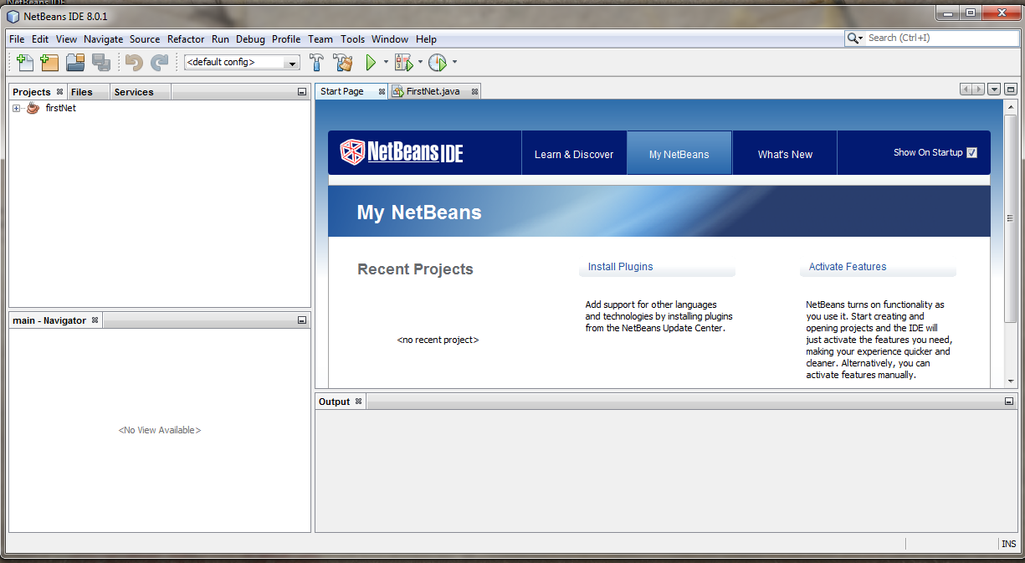
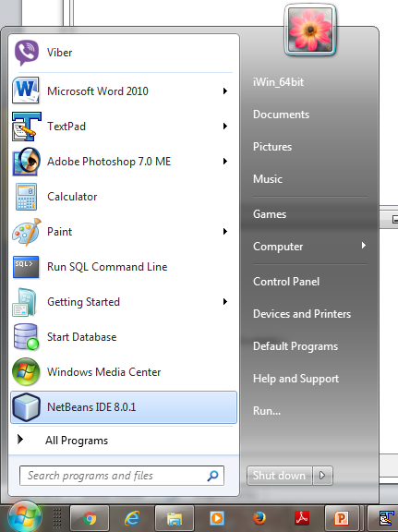
Open NetBeans environment

Slide 3
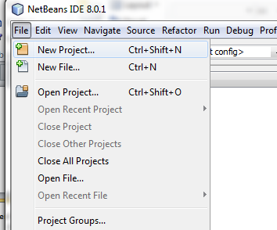
Go to file New project

Slide 4
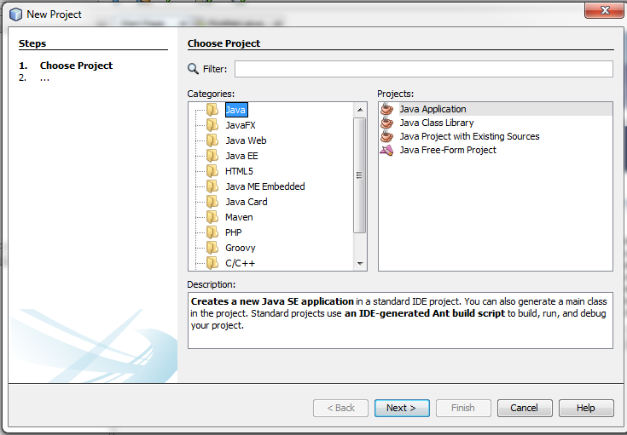
1- select java 2- select java Application 3-select next
1
2
3

Slide 5
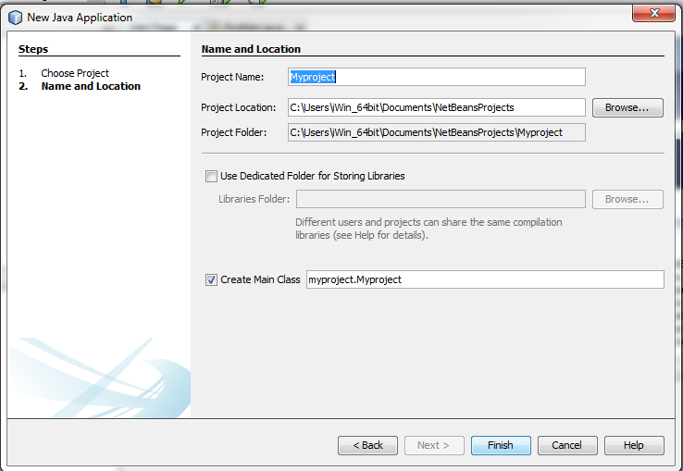
1-name your project for example Myproject 2-select finish
1
2

Slide 6
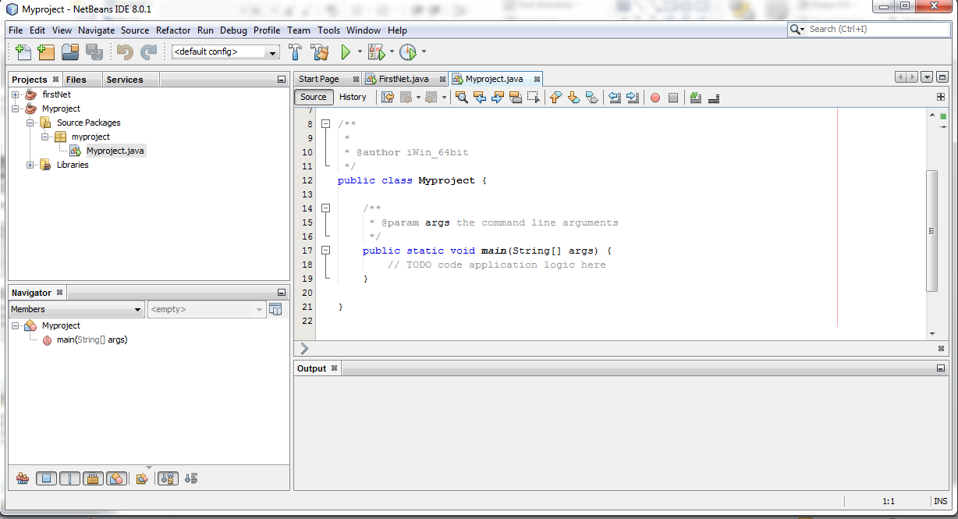
Start your code in main
Write your code in main method

Slide 7
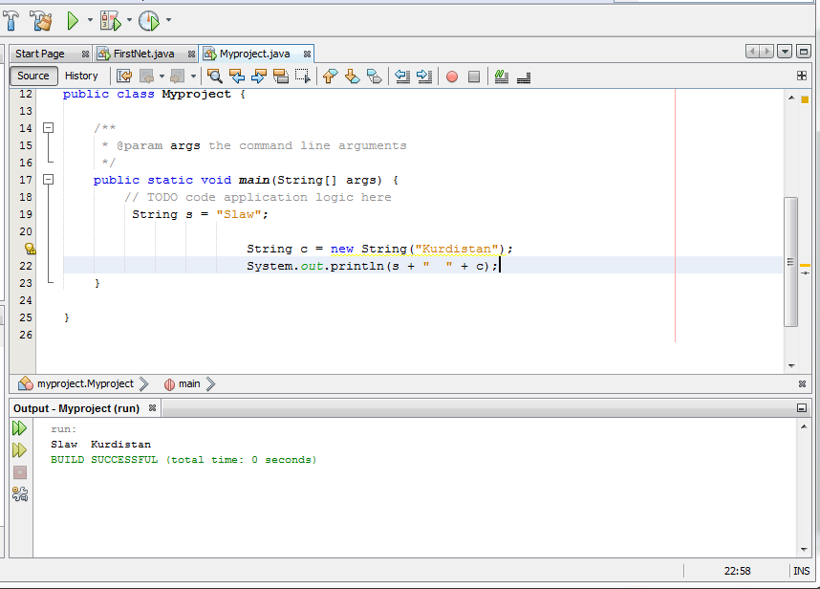
1-Your code. 2-run your code. 3-see the out put.
2
1
3

Slide 8
practice
Suppose you have a sentence like following
“ You can Change The World ”
1- write a program for counting the number of character in the string and show the result.
2- change all letters to capital letter and show it again.
3- search for “can” world in the sentence .

Slide 9
practice
Suppose you have two strings Str1 and str2
concatenate both strings and show them again.
compare str1 to str2 and show both are same or not.
Show what character in position 5 in str1.

